Slide 1
Dealing with Data 1: Cleaning
UIUC ECON 474 Econometrics of Policy Evaluation

Slide 2
Overview
Reading for next lecture: R4DS Ch. 13-16
Today:
Real world data!
Manipulating data into analysis-ready format (“tidy”)
Plotting our lovely data

Slide 3
Cleaning Data
Preparing your data for analysis

Slide 4
Data “in the wild” are rarely analysis ready
“Happy families are all alike; every unhappy family is unhappy in its own way.” –– Leo Tolstoy
“Tidy datasets are all alike, but every messy dataset is messy in its own way.” –– Hadley Wickham

Slide 5
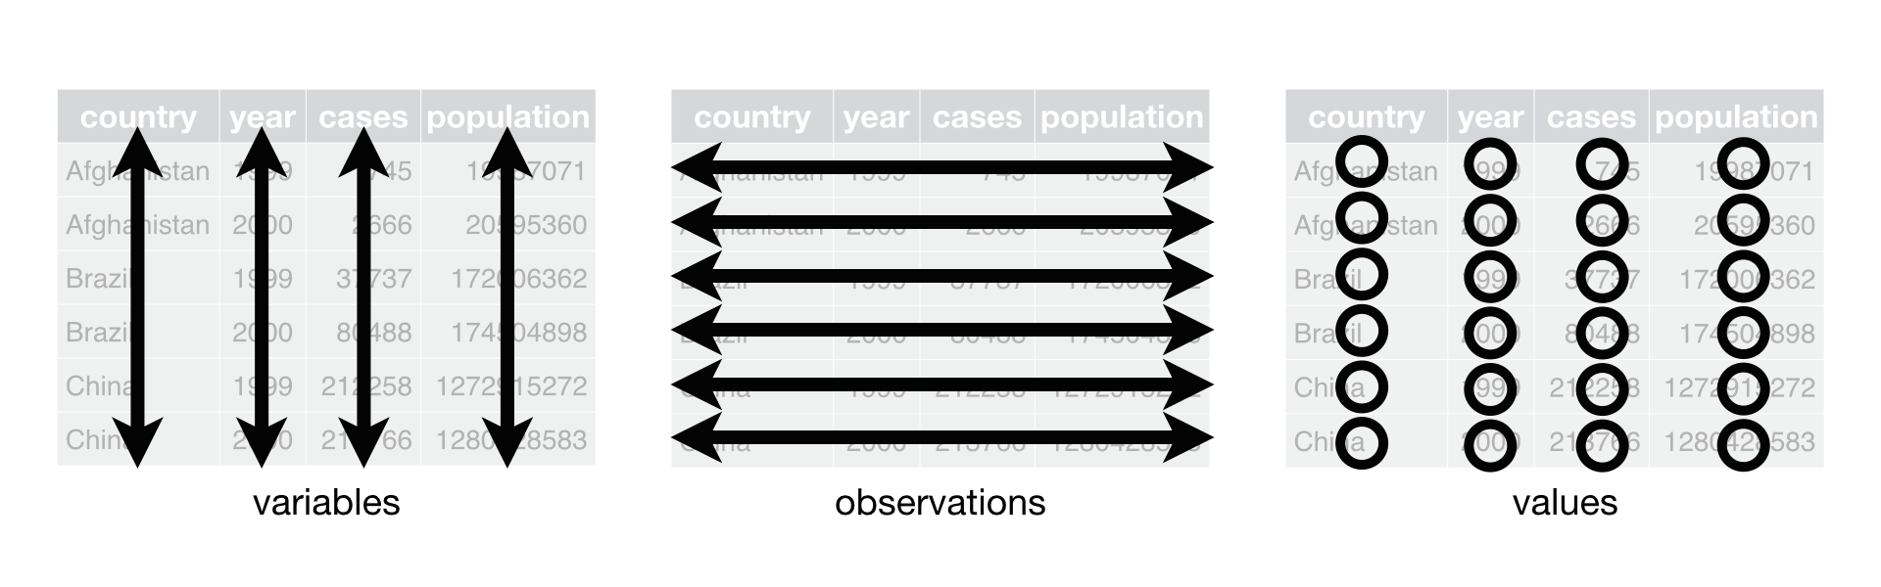
Each variable needs its own column: “tidy”

Slide 6
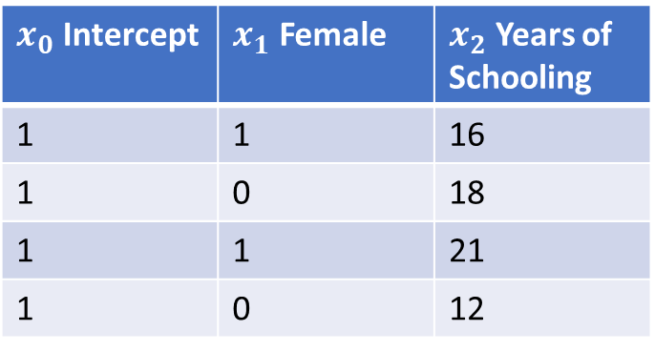
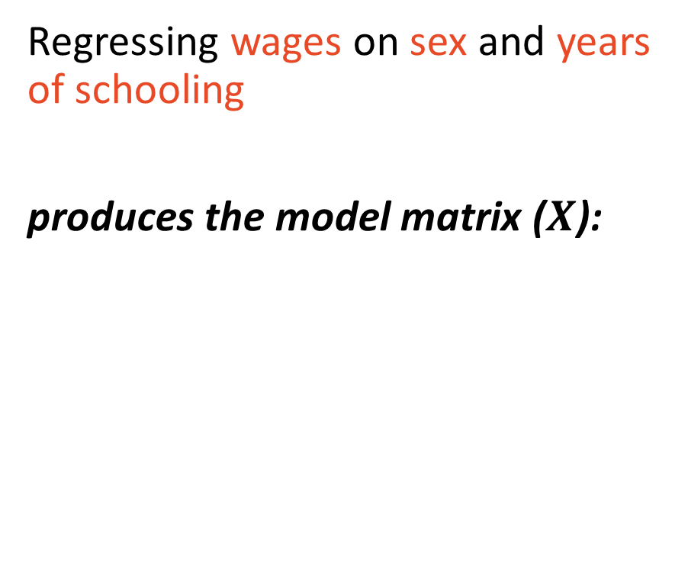
You cannot statistically analyze non-“tidy” data
We need data in “tidy” format to be able to perform analysis on it.
For example, the tidy data…
Regressing wages on sex and years of schooling
produces the model matrix ($X$):
Wage | Sex | Years of Schooling
$50,000 | Female | 16
$25,000 | Male | 18
$100,000 | Female | 21
$70,000 | Male | 12
$x_{0}$ Intercept | $x_{1}$ Female | $x_{2}$ Years of Schooling
1 | 1 | 16
1 | 0 | 18
1 | 1 | 21
1 | 0 | 12

Slide 7
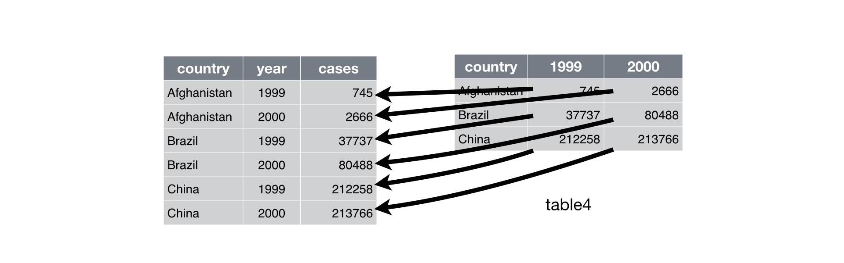
Pivoting longer to “tidy” format

Slide 8
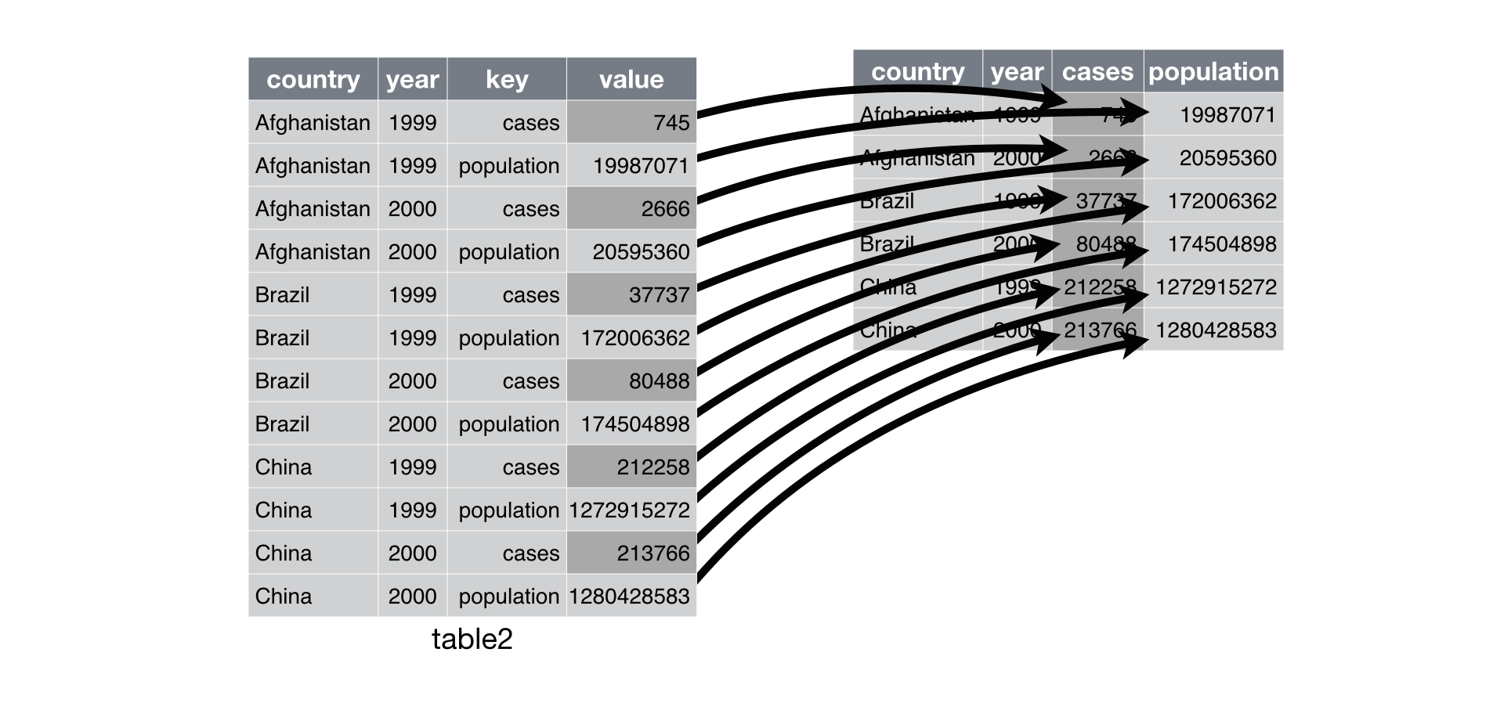
Pivoting wider to “tidy” format

Slide 9
Packages have functions for advanced tasks
“Tidying” data in base R is non-trivial
Requires messy, convoluted code
Fortunately, R users write functions to help with many tasks including cleaning data
These functions are distributed freely in packages
For example, the dplyr package has many functions for manipulating data

Slide 10
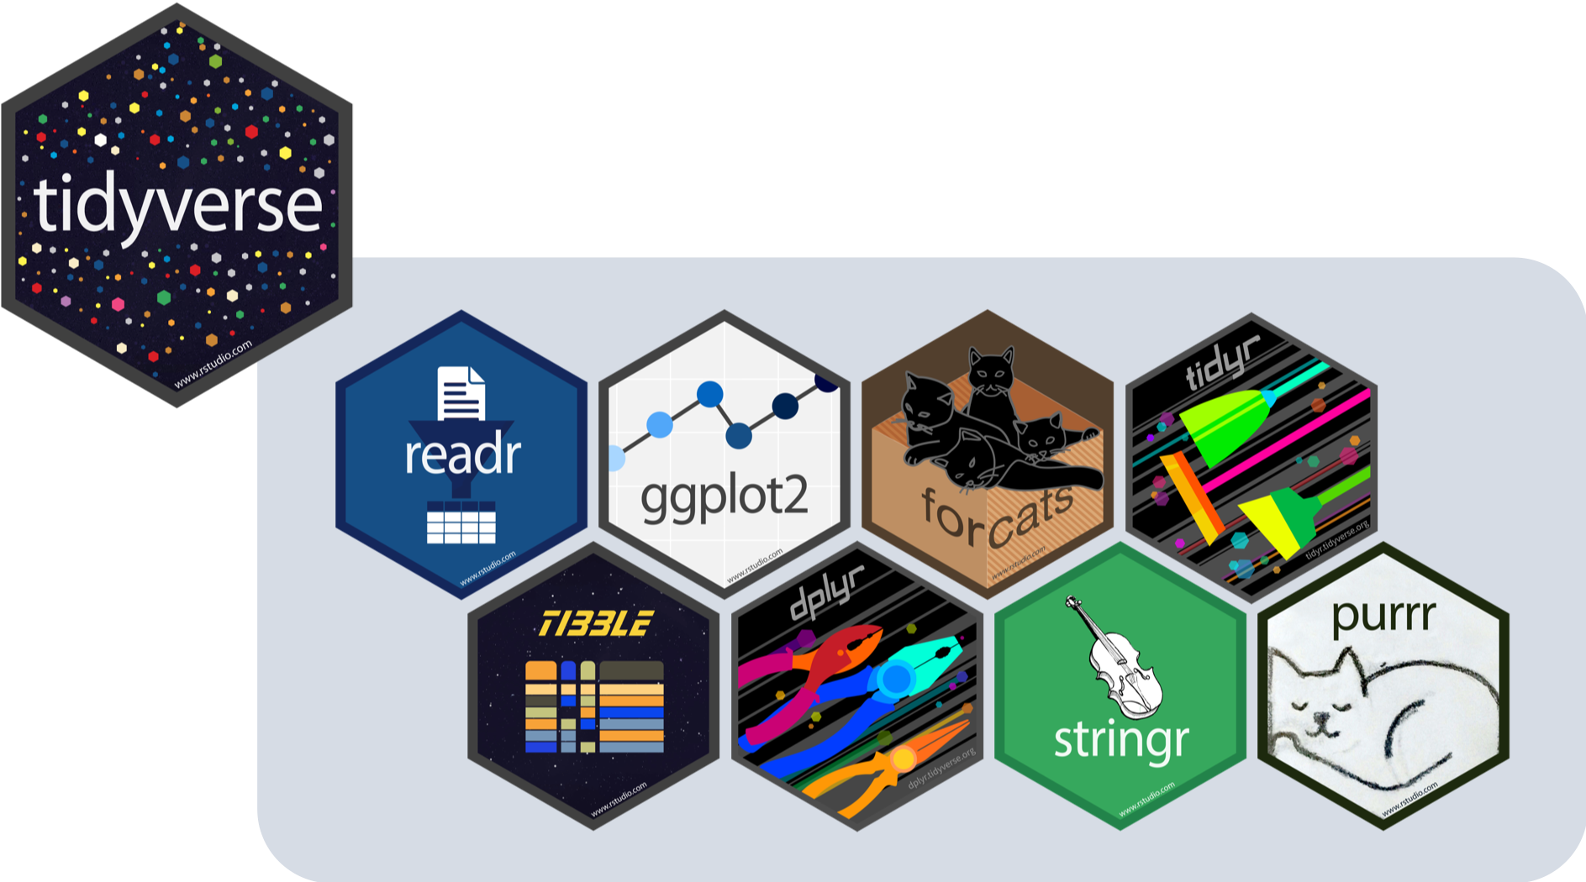
Tidyverse
A package of packages: your one-stop shop for dealing with data

Slide 11








The tidy 8
Reading in standard data formats (.csv, .txt, .fwf)
Data frame quality-of-life improvements
Elegant data visualizations using a grammar of graphics
Grammar of data manipulation
Tools for categorical data (factors)
Common string manipulations and operations
Tidy messy data
Functional programming toolkit

Slide 12
Time to practice cleaning data!

